Slide 1


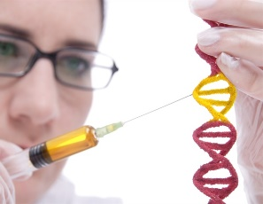

University Of Basrah
Al-Zahraa College Of Medicine
Ministry Of Higher Education
And Scientific Research
Module: Molecule, Gene and Disease
Semester: 2
Session: 4, Lecture: 7
Duration: 2 hr.
Lecture Title: Nucleotides and nucleic acids
Module staff:
Dr. Ban M. Saleh
Dr. Abeer Leyali Mohammed
Dr. Hazim Talib
Dr. Wameedh Hashim Alqatrani
Dr. Amani Niama
Dr. Zainab Muzahim
Assist.Lect. Amna Shaker
Assist.Lect. Amal Adil
Module staff:
Dr. Hussein K. Abdul-Sada
Dr. Farqad M. Al-Hamdani
Dr. Zainab Khalid
Dr. Maiada Abdulah
Dr. Douaa Saadi Salim
Assist.Lect.Mohammed Abdullah
Assist.Lect. Ibrahim Ayad
Module staff:
Dr. Inas Ryadh
Dr. Hamid Jadoa
Dr. Ilham Mohamed Jawad
Dr. Zainab Ahmad
Dr. Shant Sunbat
Assist.Lect. Eatidal Akram
Assist.Lect. Taif Ibrahim
.
This Lecture was loaded in blackboard and you can find the material in:
(Lippincott’s Illustrated Reviews: Cell and Molecular Biology Chapter 5)
For more detailed instructions, any question, or you have a case you need help
in, please post to the group of session

Slide 2

Learning Objectives (LO)
1. Recognize the structural components of DNA and RNA molecules. (LO. 1)
2.Recognize and apply the conventions used to represent these components and the conventions used to represent DNA or RNA base sequences. (LO.2)
3. Explain polarity of a DNA or RNA chain. (LO.3)
4. Explain the importance of hydrogen-bonding and base-pairing in defining nucleic acid secondary structure. (LO.4)
5. Describe the key features of the DNA double helix. (LO.5)

Slide 3
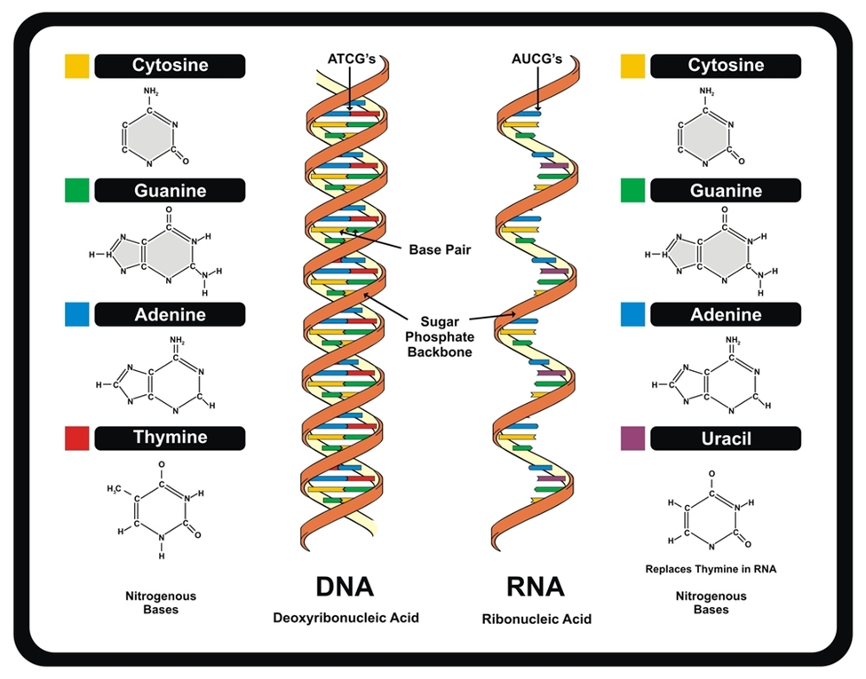
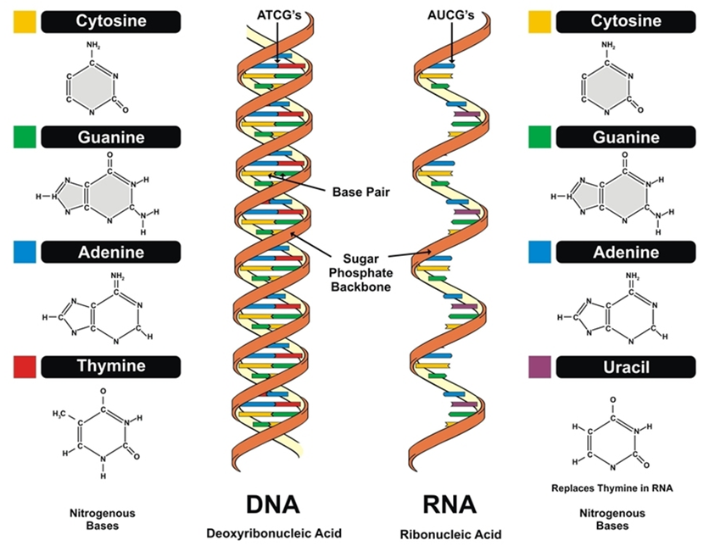
Nucleic acids LO.1
Nucleic acids are required for the storage and expression of genetic information. There are two chemically distinct types of nucleic acids: deoxyribonucleic acid (DNA) and ribonucleic acid (RNA).
Base pare
Sugar phosphate backbone

Slide 4
Nucleic acids LO.1
DNA
DNA is a polymer of deoxyribonucleoside monophosphates (dNMP) covalently linked by phosphodiester bonds. With the exception of a few viruses that contain single-stranded DNA (ssDNA), DNA exists as a double-stranded molecule (dsDNA), in which the two strands wind around each other, forming a double helix.
Is found in the nucleus with small amounts in mitochondria and chloroplast.

Slide 5
The structural components of DNA & RNA molecule
LO. 1
Nucleotides – the monomer or building blocks of nucleic acids (DNA & RNA).
Components of nucleotide:
Base, Sugar and Phosphate
nucleotide serves diverse physiologic functions as protein synthesis, regulatory cascades & signal transduction pathways.
Base pare
Sugar phosphate backbone

Slide 6
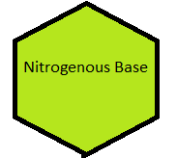
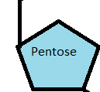
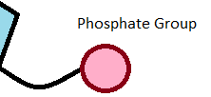
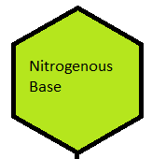
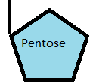
Nucleotide Vs. Nucleoside
LO. 1
Nitrogenous base + Sugar + Phosphate= Nucleotide
Nitrogenous base + Sugar = Nucleoside
H.W.
Nomenclature of Nucleotides

Slide 7
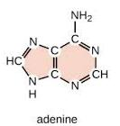
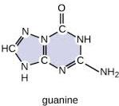
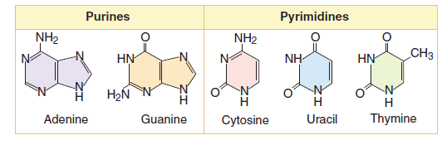
Types of nitrogen basis in nucleic acids LO.1
1. Purines
2. Pyrimidines
DNA
RNA
instead of Thymine

Slide 8
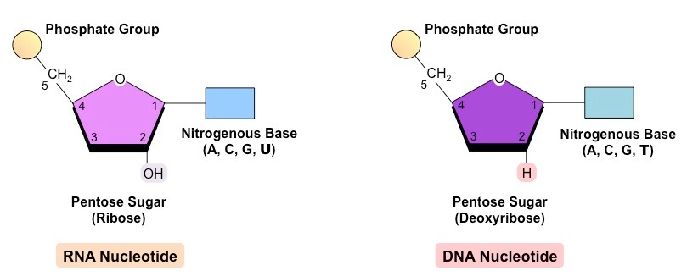

Type of sugar and nitrogen bases in DNA & RNA
LO. 1
DNA Nucleotide
RNA Nucleotide

Slide 9
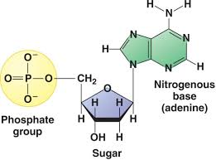
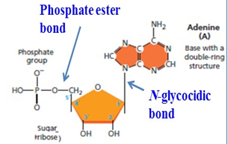
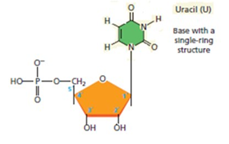
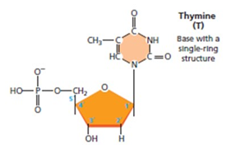
Nucleotides LO.1
Deoxribonucleotide in DNA
Ribonucleotide in RNA

Slide 10
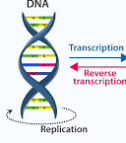
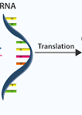

The Central Dogma of Molecular biology
LO. 1
In most organism DNA is the storage of genetic information with exception of RNA viruses.
The Central Dogma: is the flow of information from DNA to RNA to Protein
Retrovirus: ex : human
immunodeficiency virus (HIV): The information flow:
Reverse transcription
RNA DNA RNA Protein

Slide 11
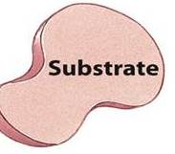
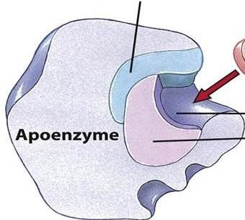
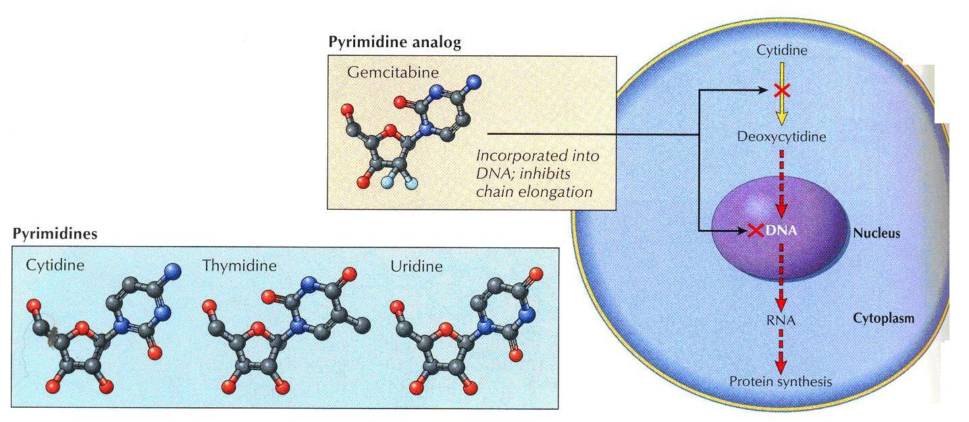


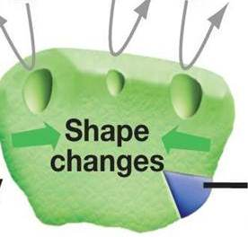
Biomedical importance of nucleotides
LO. 1
Form part of many coenzymes
Cofactor
Serve as donors of phosphoryl groups, sugars, or lipids
Regulation of enzyme activity
Active site
Coenzyme
Synthetic purine & pyrimidine analogs are employed for chemotherapy of cancer & ADIS. Also as suppressors of the immune response during organ transplantation
Holoenzyme
Regulatory molecule

Slide 12
Biomedical importance of nucleotides
LO. 1
Storage and transfer of energy ( ATP & GTP)
Precursors of nucleic acid DNA & RNA
Storage & transfer of genetic information (DNA & RNA)
Components of important co-enzyme (NAD, FAD, co-enzyme A)
Metabolic regulator such as cAMP

Slide 13
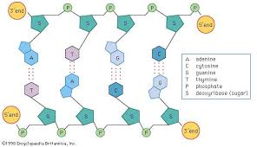
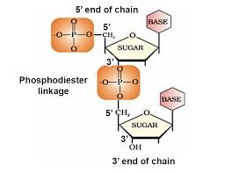
Polynucleotides LO.1
Nucleotides are covalently linked together via phosphodiester bonds
5 ˋ(Phosphoryl) end
Polynucleotides have directionality
3 ˋ(hydroxyl) end

Slide 14
Nucleic acids LO.1
RNA
RNA like DNA, is a long, unbranched macromolecule
RNA is found throughout the cell.
Single strand, consisting of nucleotide joined by 3 ̒ 5 ̒ phosphodiester bond.
H. W.
Compare between the nucleic acids DNA and RNA

Slide 15
Types of RNA and their functions
LO. 1
Type | Functions
Messenger RNA | Transfers genetics information from gene to ribosomes to synthesize protein.
Transfer RNA | Transfer amino acids to mRNA for protein synthesis.
Ribosomal RNA | Provides structural framework for ribosomes

Slide 16
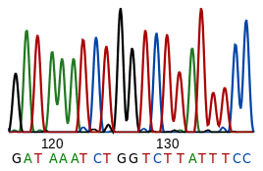

Nucleic acid sequence
LO. 2
is a succession of letters that indicate the order of nucleotides within a DNA or RNA molecule.
Specifying the sequence is equivalent to defining the covalent structure of the entire molecule.
Sequences are usually presented from 5’ end to 3’ end.

Slide 17
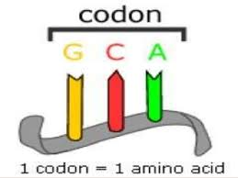
Nucleic acid sequence
LO. 2
A nucleic acid sequence is translated into the protein it encodes by means of transfer RNAs (tRNA) interacting with the ribosomal apparatus.
Transfer RNAs bind to three nucleotides at a time and divide the nucleic acid sequence into codons, each specifying one amino acid.

Slide 18
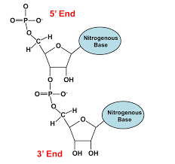
Polarity
LO. 3
Each single-stranded nucleic acid chain has a polarity, two distinct ends: a 5’ end with a free phosphate and a 3’end with a free OH-group.
The polarity in DNA and RNA is derived from the oxygen and nitrogen atoms in the backbone. Nucleic acids are formed when nucleotides come together through phosphodiester linkages between the 5' and 3' carbon atoms.

Slide 19
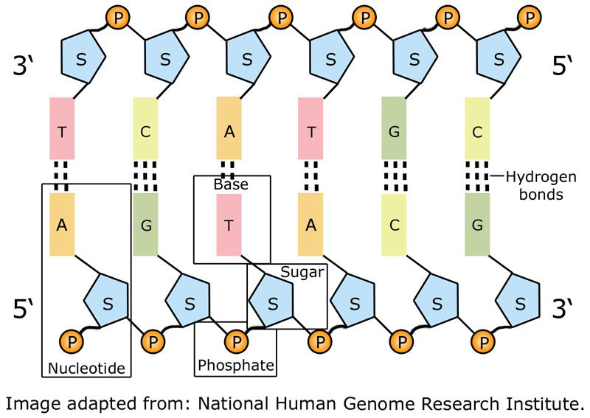






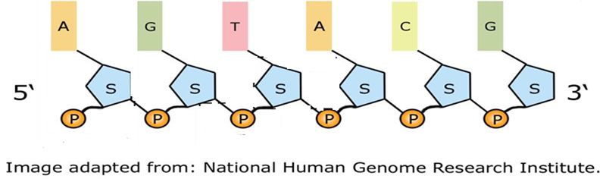
Hydrogen bond
LO. 4
In double stranded nucleic acids the bases of each base pair is held together by hydrogen bonds, 3 hydrogen bonds in the GC-base pair and 2 hydrogen bonds for the AT- and AU-base pair.

Slide 20
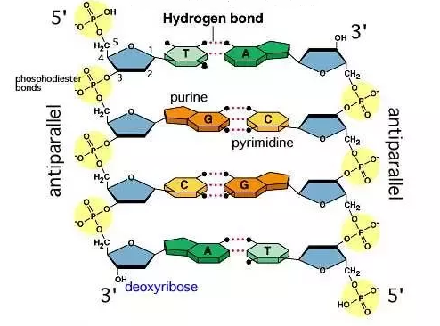
Hydrogen bonds importance
LO. 4
Interact to stabilize and form the double helix structure.
Hydrogen bonds between bases can be made and broken easily, allowing DNA to undergo accurate replication and repair.
(disruption the hydrogen bonds between the paired bases using acidic or alkaline pH or heating).

Slide 21
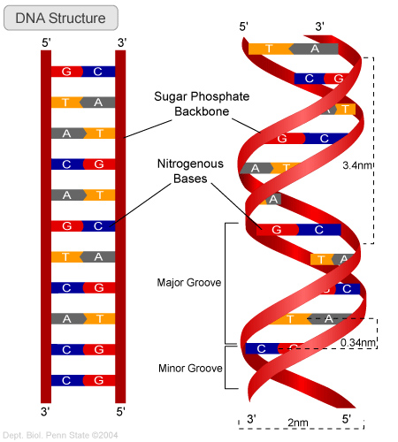
LO. 5
Features of DNA double helix
According to Watson and Crick model, DNA characterizes by:
Base pairing is highly specific: A in one chain pairs with T in the opposite chain by two hydrogen bonds, and C pairs with G by three bonds.
The two chains are twisted (coiled) around each other in a right-handed to form a double helix

Slide 22
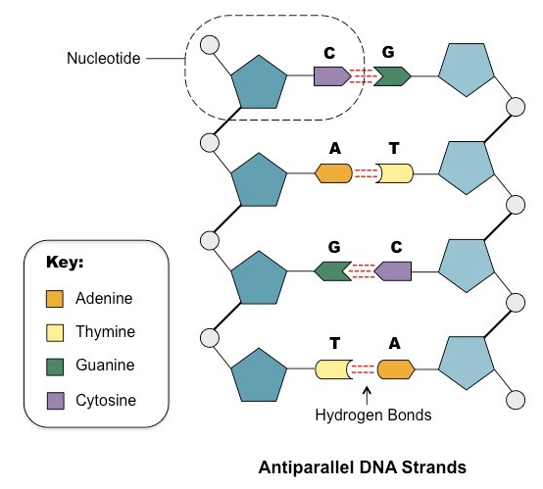
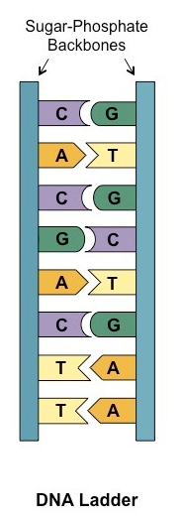
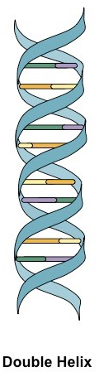

LO. 5
Features of DNA double helix
Antiparallel: DNA is composed of two polynucleotide chains running in opposite directions. (Why)?

Slide 23
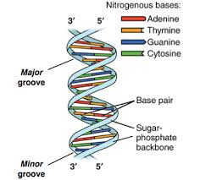
DNA double helix
LO. 5
The spatial relationship between the two strands creates—the major and minor grooves in DNA.
The hydrophobic base pairs are packed in the interior of the double helix.
Each base pair is of similar width, thus holding (the hydrophilic) sugar–phosphate back- bones an equal distance apart along the DNA molecule.

Slide 24
DNA double helix
LO. 5
The members of each base pair can fit together within the double helix because the two strands of the helix run antiparallel to each other—that is, they are oriented with opposite polarities
The antiparallel sugar–phosphate strands then twist around each other to form a double helix containing 10 base pairs per helical turn.

Slide 25

Negative charge of DNA helix
LO. 5
The third -OH group on the phosphate is free and
dissociates a hydrogen ion at physiologic pH.
Therefore, DNA helix has negative charges coating its surface that facilitate the binding of specific proteins(histones and non-histones).

Slide 26
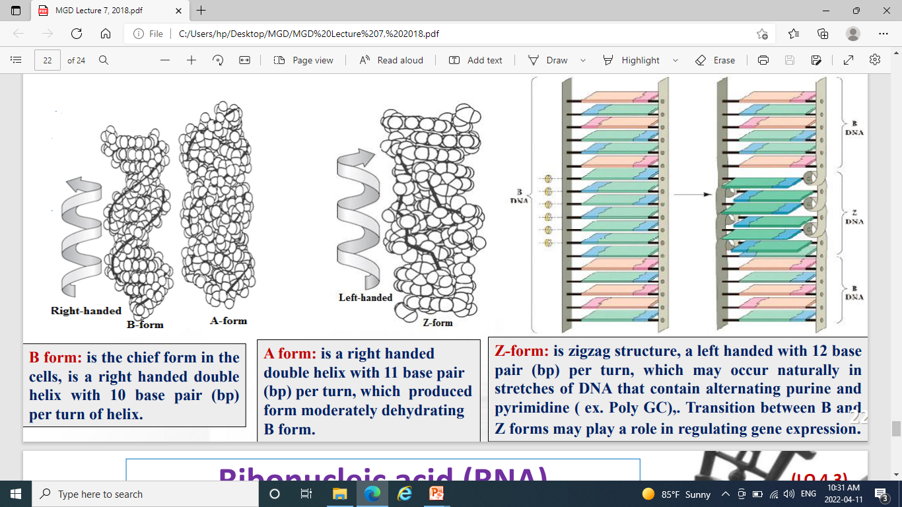
LO. 5
There are three major structural forms of DNA that all exhibit Watson and Crick complementary base pairing and antiparallel: A, B and Z forms:

Slide 27

LO. 5
Z-form: is zigzag structure, a left handed with 12 base pair (bp) per turn, which may occur naturally in stretches of DNA that contain alternating purine and pyrimidine ( ex. Poly GC),. Transition between B and Z forms may play a role in regulating gene expression

Slide 28


